Slide 1

AL NASHI TRANSPORTATION CHARGE PREDICITON MACHINE LEARNING
SUBMITTED BY :
MUHAMMED SAVAD K
DATA SCIENCE
MACHINE LEARNING MINI PROJECT

Slide 2
AL NASHI
Al nashi is currently leading transportation company in saudi arabia
Al Nashi is company dedicated to providing efficient and reliable transportation solutions. With years of experience in the industry, we have built a reputation for excellence, serving our clients with utmost professionalism and delivering on our promises.
At Al Nashi, our mission is to streamline transportation services and enhance connectivity, ensuring seamless movement of people and goods. We strive to exceed our clients' expectations by providing safe, timely, and cost-effective transportation solutions while minimizing our impact on the environment.

Slide 3
Description
In this project, the goal is to develop a machine learning model that can predict transportation charges based on various factors. The model will take into variable such as Destination,vehicle type, shipment type, and any other relevant features. By analyzing historical data, the model will learn patterns and relationships to make accurate predictions on transportation charges. This prediction can be valuable for logistics companies, freight forwarders, or businesses that frequently ship goods and need estimates for budgeting and planning purposes.

Slide 4
About Al Nashi Transportation Data Set
Al nashi transportation data set in which we have diffrent attributes for predicting transportation charges
we will calculate the charges depends on 1300 observations and 3 attributes
Feature names:
Date,From,Destination,Vehicle type,owner,drivername,charges

Slide 5
Data collection
Data preprocessing
Data visualization
Model selection
Model evaluation
Model deployment

Slide 6
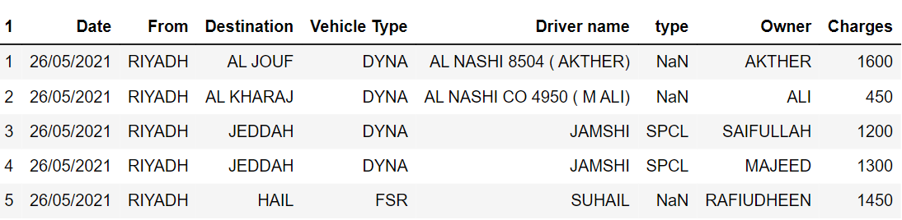
Data Collection
collected data from Al nashi transportation company

Slide 7
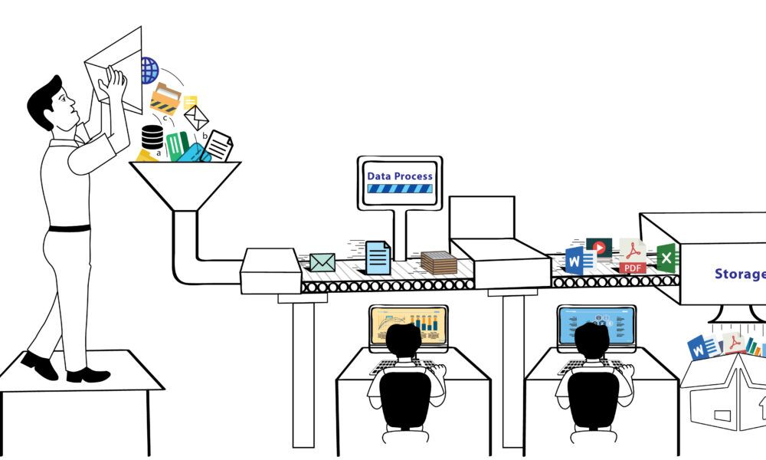
Data preprocessing
Outliers detection
and removal
5
Feature selection
4
Handling Nullvalues
3
Handling Nullvalues
2
Handling Nullvalues
1

Slide 8
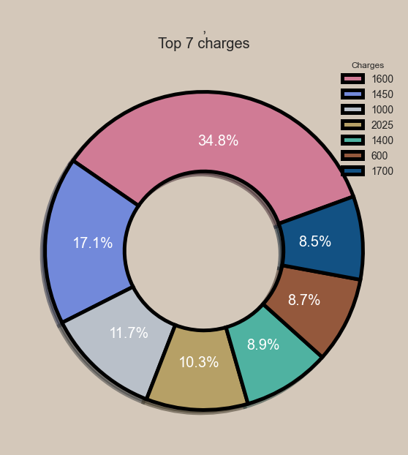
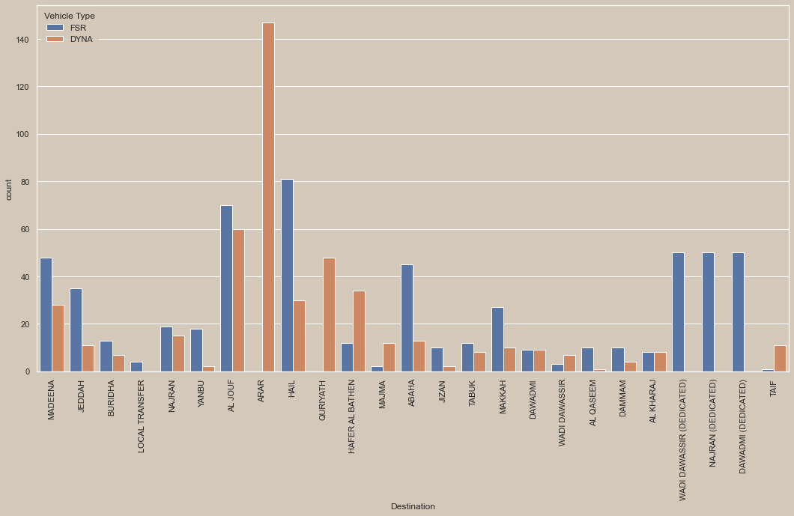
Data visualization

Slide 9
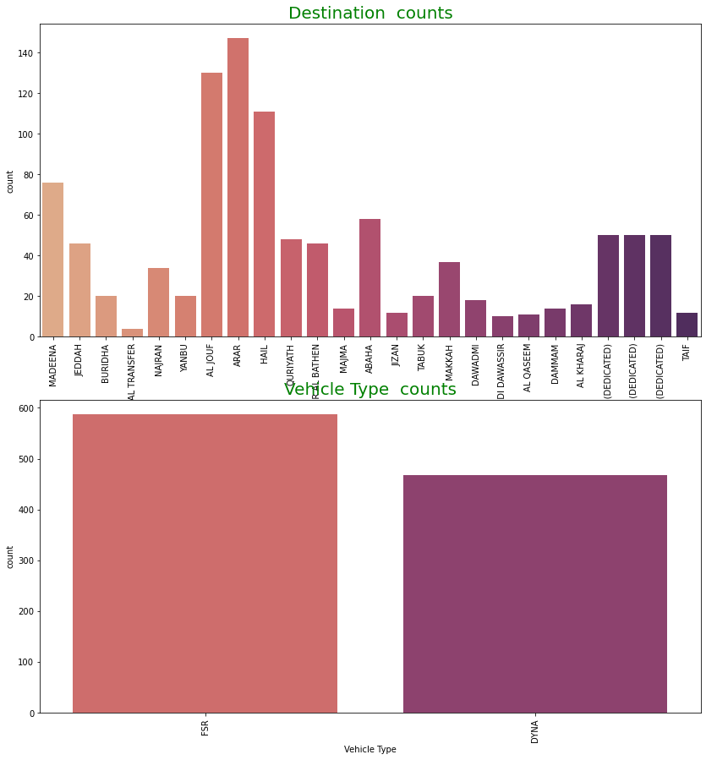
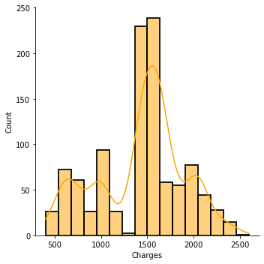
CONT:

Slide 10
Model selection&training
Here iam Using hypertuning for selecting best model
Here RandomforestRegressor and DecsiontreeRegressor both are giving good scores and i randomly selected RandomforestRegressor
After that training the model and taking score

Slide 11
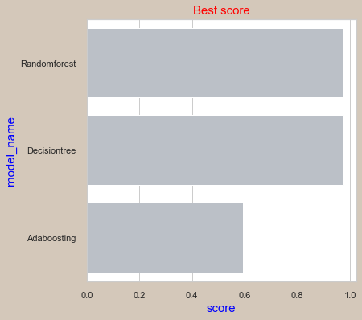
Model comparison

Slide 12
Model Deployment
Here model Deployment using Django Frame work
Django is a popular python frame work f
we can create website using Django

Slide 13
Other links:
http://localhost:8888/notebooks/1%20%20-Techols%20data%20science/projects/projects/Transpotation.ipynb

Slide 14
THANK YOU FOR YOUR ATTENTION

